Slide 1

Sorting Algorithms
CS 2321
Data Structures and Algorithms
Dr. Mahdi Khemakhem

Slide 2
Outlines
Insertion sort
Merge sort
Quick sort

Slide 3
1. Insertion sort
Reading: Text Book (Weiss) Weiss 7.1, 7.2

Slide 4

Insertion sort
1) Initially p = 1
2) Let the first p elements be sorted.
3) Insert the (p+1)th element properly in the list so that now p+1 elements are sorted.
4) increment p and go to step (3)

Slide 5
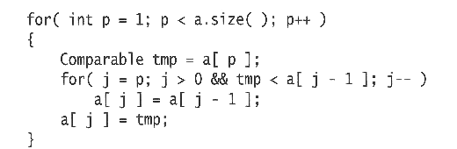
Insertion Sort...
See the flash animation
https://courses.cs.vt.edu/csonline/Algorithms/Lessons/InsertionCardSort/insertioncardsort.swf
Consists of N - 1 passes
For pass p = 1 through N - 1, ensures that the elements in positions 0 through p are in sorted order
elements in positions 0 through p - 1 are already sorted
move the element in position p left until its correct place is found among the first p + 1 elements

Slide 6
Example
To sort the following numbers in increasing order:
34 8 64 51 32 21
P = 1; tmp = 8;
34 > tmp, so second element is set to 34.
We have reached the front of the list. Thus, 1st position = tmp
After first pass: 8 34 64 51 32 21
(first 2 elements are sorted)

Slide 7
P = 2; tmp = 64;
34 < 64, so stop at 3rd position and set 3rd position = 64
After second pass: 8 34 64 51 32 21
(first 3 elements are sorted)
P = 3; tmp = 51;
51 < 64, so we have 8 34 64 51 32 21,
34 < 51, so stop at 3rd position, set 3rd position = tmp,
After third pass: 8 34 51 64 32 21
(first 4 elements are sorted)
P = 4; tmp = 32,
32 < 64, so 8 34 51 64 32 21,
32 < 51, so 8 34 51 32 64 21,
next 32 < 34, so 8 34 32, 51 64 21,
next 32 > 8, so stop at 2nd position and set 2nd position = 32,
After fourth pass: 8 32 34 51 64 21
P = 5; tmp = 21, . . .
After fifth pass: 8 21 32 34 51 64

Slide 8
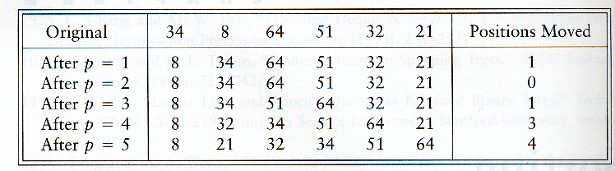
Insertion Sort

Slide 9
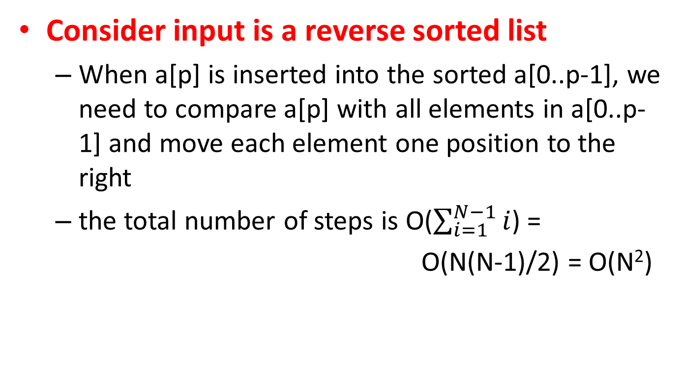
Analysis: worst-case running time
Consider input is a reverse sorted list
When a[p] is inserted into the sorted a[0..p-1], we need to compare a[p] with all elements in a[0..p-1] and move each element one position to the right
the total number of steps is O($\sum_{i=1}^{N−1}{i}$) =
O(N(N-1)/2) = O(N²)

Slide 10
Analysis: best case
Consider input is already sorted in increasing order
When inserting A[p] into the sorted A[0..p-1], only need to compare A[p] with A[p-1] and there is no data movement
For each iteration of the outer for-loop, the inner for-loop terminates after checking the loop condition once => O(N) time
If input is nearly sorted, insertion sort runs fast

Slide 11
2. Merge sort
Reading: Text Book (Weiss) Weiss 7.6

Slide 12
Mergesort
Based on divide-and-conquer strategy
Divide the list into two smaller lists of about equal sizes
Sort each smaller list recursively
Merge the two sorted lists to get one sorted list
How do we divide the list? How much time needed?
How do we merge the two sorted lists? How much time needed?

Slide 13
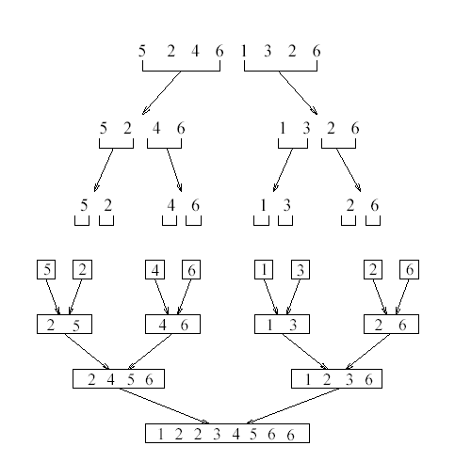

Slide 14
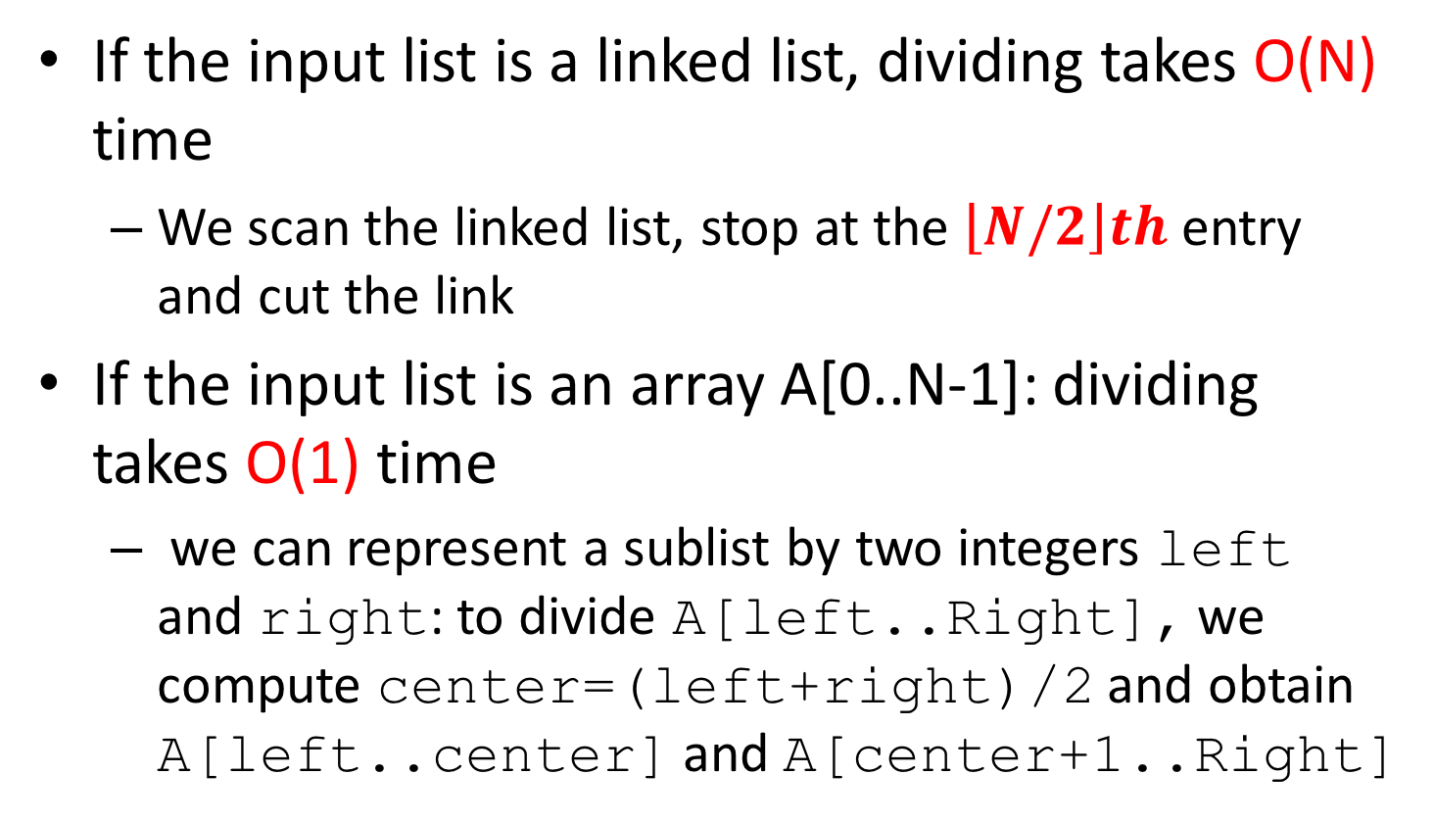
Dividing
If the input list is a linked list, dividing takes O(N) time
We scan the linked list, stop at the $\left\lfloor N/2\right\rfloor th$ entry and cut the link
If the input list is an array A[0..N-1]: dividing takes O(1) time
we can represent a sublist by two integers left and right: to divide A[left..Right], we compute center=(left+right)/2 and obtain A[left..center] and A[center+1..Right]

Slide 15
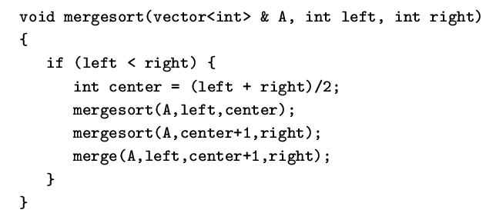
Mergesort
Divide-and-conquer strategy
recursively mergesort the first half and the second half
merge the two sorted halves together

Slide 16
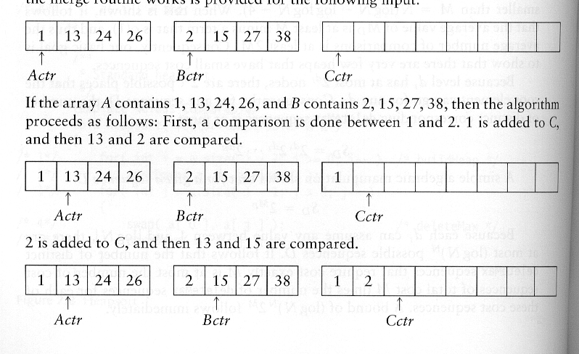
How to merge?
Input: two sorted array A and B
Output: an output sorted array C
Three counters: Actr, Bctr, and Cctr
initially set to the beginning of their respective arrays
(1) The smaller of A[Actr] and B[Bctr] is copied to the next entry in C, and the appropriate counters are advanced
(2) When either input list is exhausted, the remainder of the other list is copied to C

Slide 17
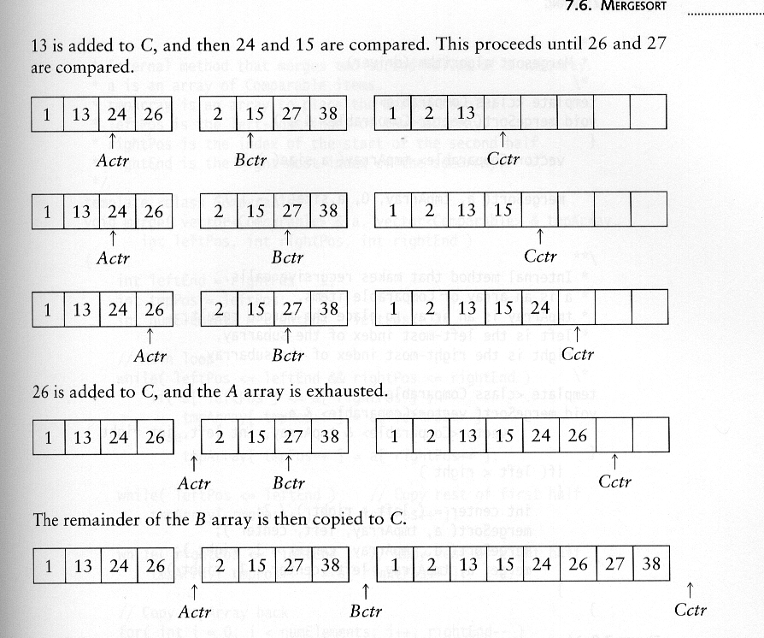
Example: Merge

Slide 18
Example: Merge...
Running time analysis:
Clearly, merge takes O(m1 + m2) where m1 and m2 are
the sizes of the two sublists.

Slide 19
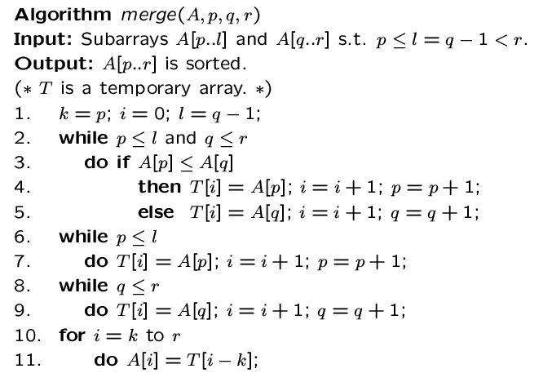

Slide 20
Analysis of mergesort
Let T(N) denote the worst-case running time of mergesort to sort N numbers.
Assume that N is a power of 2.
Divide step: O(1) time
Conquer step: 2 T(N/2) time
Combine step: O(N) time
Recurrence equation:
T(1) = 1
T(N) = 2T(N/2) + N

Slide 21
Analysis: solving recurrence
Since N=2^{k}, we have k=log₂ n

Slide 22
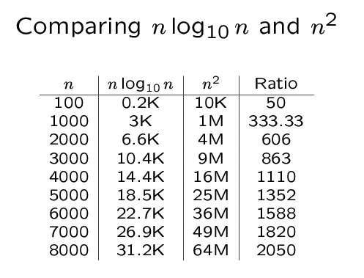
Comparing n log n and n²

Slide 23
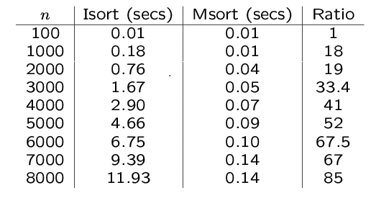
An experiment
Code from textbook (using template)
Unix time utility

Slide 24
3. Quick sort
Reading: Text Book (Weiss) Weiss 7.7

Slide 25
Introduction
Fastest known sorting algorithm in practice
Average case: O(N log N)
Worst case: O(N²)
But, the worst case seldom happens.
Another divide-and-conquer recursive algorithm like mergesort

Slide 26
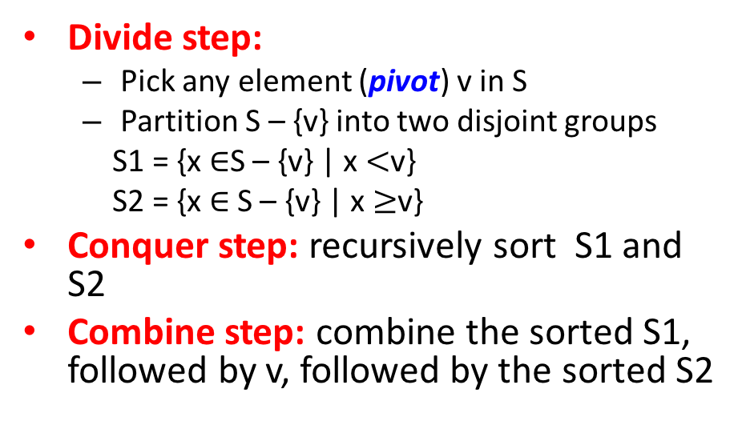
Quicksort
S
Divide step:
Pick any element (pivot) v in S
Partition S – {v} into two disjoint groups
S1 = {x $∈$S – {v} | x $<$v}
S2 = {x $∈$S – {v} | x $≥$v}
Conquer step: recursively sort S1 and S2
Combine step: combine the sorted S1, followed by v, followed by the sorted S2
v
v
S1
S2

Slide 27
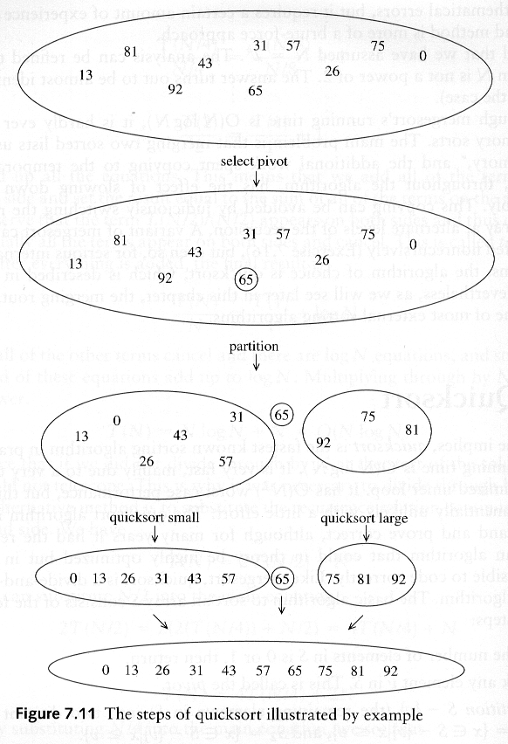
Example: Quicksort

Slide 28
Example: Quicksort...

Slide 29
Pseudocode
Input: an array A[p, r]
Quicksort (A, p, r) {
if (p < r) {
q = Partition (A, p, r) //q is the position of the pivot element
Quicksort (A, p, q-1)
Quicksort (A, q+1, r)
}
}

Slide 30
Partitioning
Partitioning
Key step of quicksort algorithm
Goal: given the picked pivot, partition the remaining elements into two smaller sets
Many ways to implement
We will learn an easy and efficient partitioning strategy here.
How to pick a pivot will be discussed later

Slide 31
Partitioning Strategy
Want to partition an array A[left .. right]
First, get the pivot element out of the way by swapping it with the last element. (Swap pivot and A[right])
Let i start at the first element and j start at the next-to-last element (i = left, j = right – 1)
swap
5
6
4
6
3
12
19
5
6
4
19
3
12
6
pivot
i
j

Slide 32
Partitioning Strategy
Want to have
A[p] < pivot, for p < i
A[p] >= pivot, for p > j
When i < j
Move i right, skipping over elements smaller than the pivot
Move j left, skipping over elements greater or equal than the pivot
When both i and j have stopped
A[i] >= pivot
A[j] < pivot
5
6
4
19
3
12
6
5
6
4
19
3
12
6
i
j
i
j

Slide 33
Partitioning Strategy
When i and j have stopped and i is to the left of j
Swap A[i] and A[j]
The large element is pushed to the right and the small element is pushed to the left
After swapping
A[i] < pivot
A[j] >= pivot
Repeat the process until i and j cross
swap
5
6
4
19
3
12
6
5
3
4
19
6
12
6
i
j
i
j

Slide 34
Partitioning Strategy
When i and j have crossed
Swap A[i] and pivot
Result:
A[p] < pivot, for p < i
A[p] >= pivot, for p > i
5
3
4
19
6
12
6
i
j
5
3
4
19
6
12
6
j
i
5
3
4
6
6
12
19
j
i

Slide 35
Small arrays
For very small arrays, quicksort does not perform as well as insertion sort
how small depends on many factors, such as the time spent making a recursive call, the compiler, etc
Do not use quicksort recursively for small arrays
Instead, use a sorting algorithm that is efficient for small arrays, such as insertion sort

Slide 36
Picking the Pivot
Use the first element as pivot
if the input is random, ok
if the input is presorted (or in reverse order)
all the elements go into S2 (or S1)
this happens consistently throughout the recursive calls
Results in O(n²) behavior (Analyze this case later)
Choose the pivot randomly
generally safe
random number generation can be expensive

Slide 37
Picking the Pivot
Use the median of the array
Partitioning always cuts the array into roughly half
An optimal quicksort (O(N log N))
However, hard to find the exact median
e.g., sort an array to pick the value in the middle

Slide 38
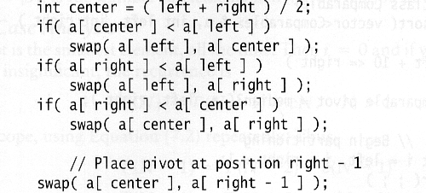
Pivot: median of three
We will use median of three
Compare just three elements: the leftmost, rightmost and center
Swap these elements if necessary so that
A[left] = Smallest
A[right] = Largest
A[center] = Median of three
Pick A[center] as the pivot
Swap A[center] and A[right – 1] so that pivot is at second last position (why?)
median3

Slide 39
Pivot: median of three
2
5
6
4
13
3
12
19
6
A[left] = 2, A[center] = 13, A[right] = 6
2
5
6
4
6
3
12
19
13
Swap A[center] and A[right]
2
5
6
4
6
3
12
19
13
Choose A[center] as pivot
pivot
2
5
6
4
19
3
12
6
13
Swap pivot and A[right – 1]
pivot
Note we only need to partition A[left + 1, …, right – 2]. Why?

Slide 40
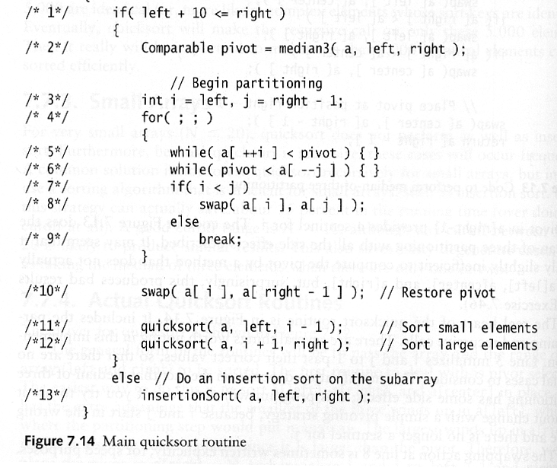
Main Quicksort Routine
Choose pivot
Partitioning
Recursion
For small arrays

Slide 41
Partitioning Part
Works only if pivot is picked as median-of-three.
A[left] <= pivot and A[right] >= pivot
Thus, only need to partition A[left + 1, …, right – 2]
j will not run past the end
because a[left] <= pivot
i will not run past the end
because a[right-1] = pivot

Slide 42
Quicksort Faster than Mergesort
Both quicksort and mergesort take O(N log N) in the average case.
Why is quicksort faster than mergesort?
The inner loop consists of an increment/decrement (by 1, which is fast), a test and a jump.
There is no extra juggling as in mergesort.
inner loop

Slide 43
Analysis
Assumptions:
A random pivot (no median-of-three partitioning
No cut off for small arrays
Running time
pivot selection: constant time O(1)
partitioning: linear time O(N)
running time of the two recursive calls
T(N)=T(i)+T(N-i-1)+cN where c is a constant
i: number of elements in S1

Slide 44
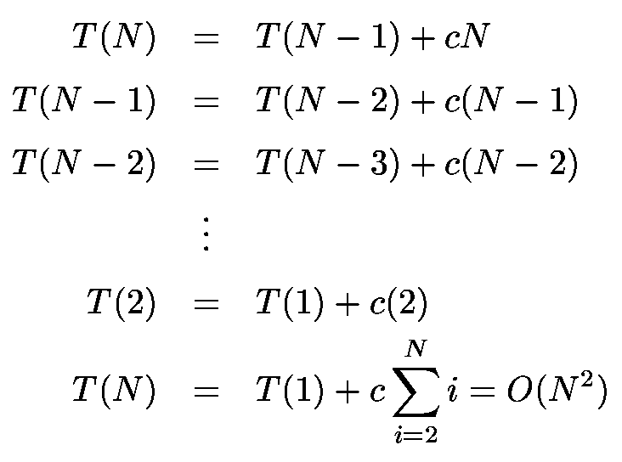
Worst-Case Analysis
What will be the worst case?
The pivot is the smallest element, all the time
Partition is always unbalanced

Slide 45
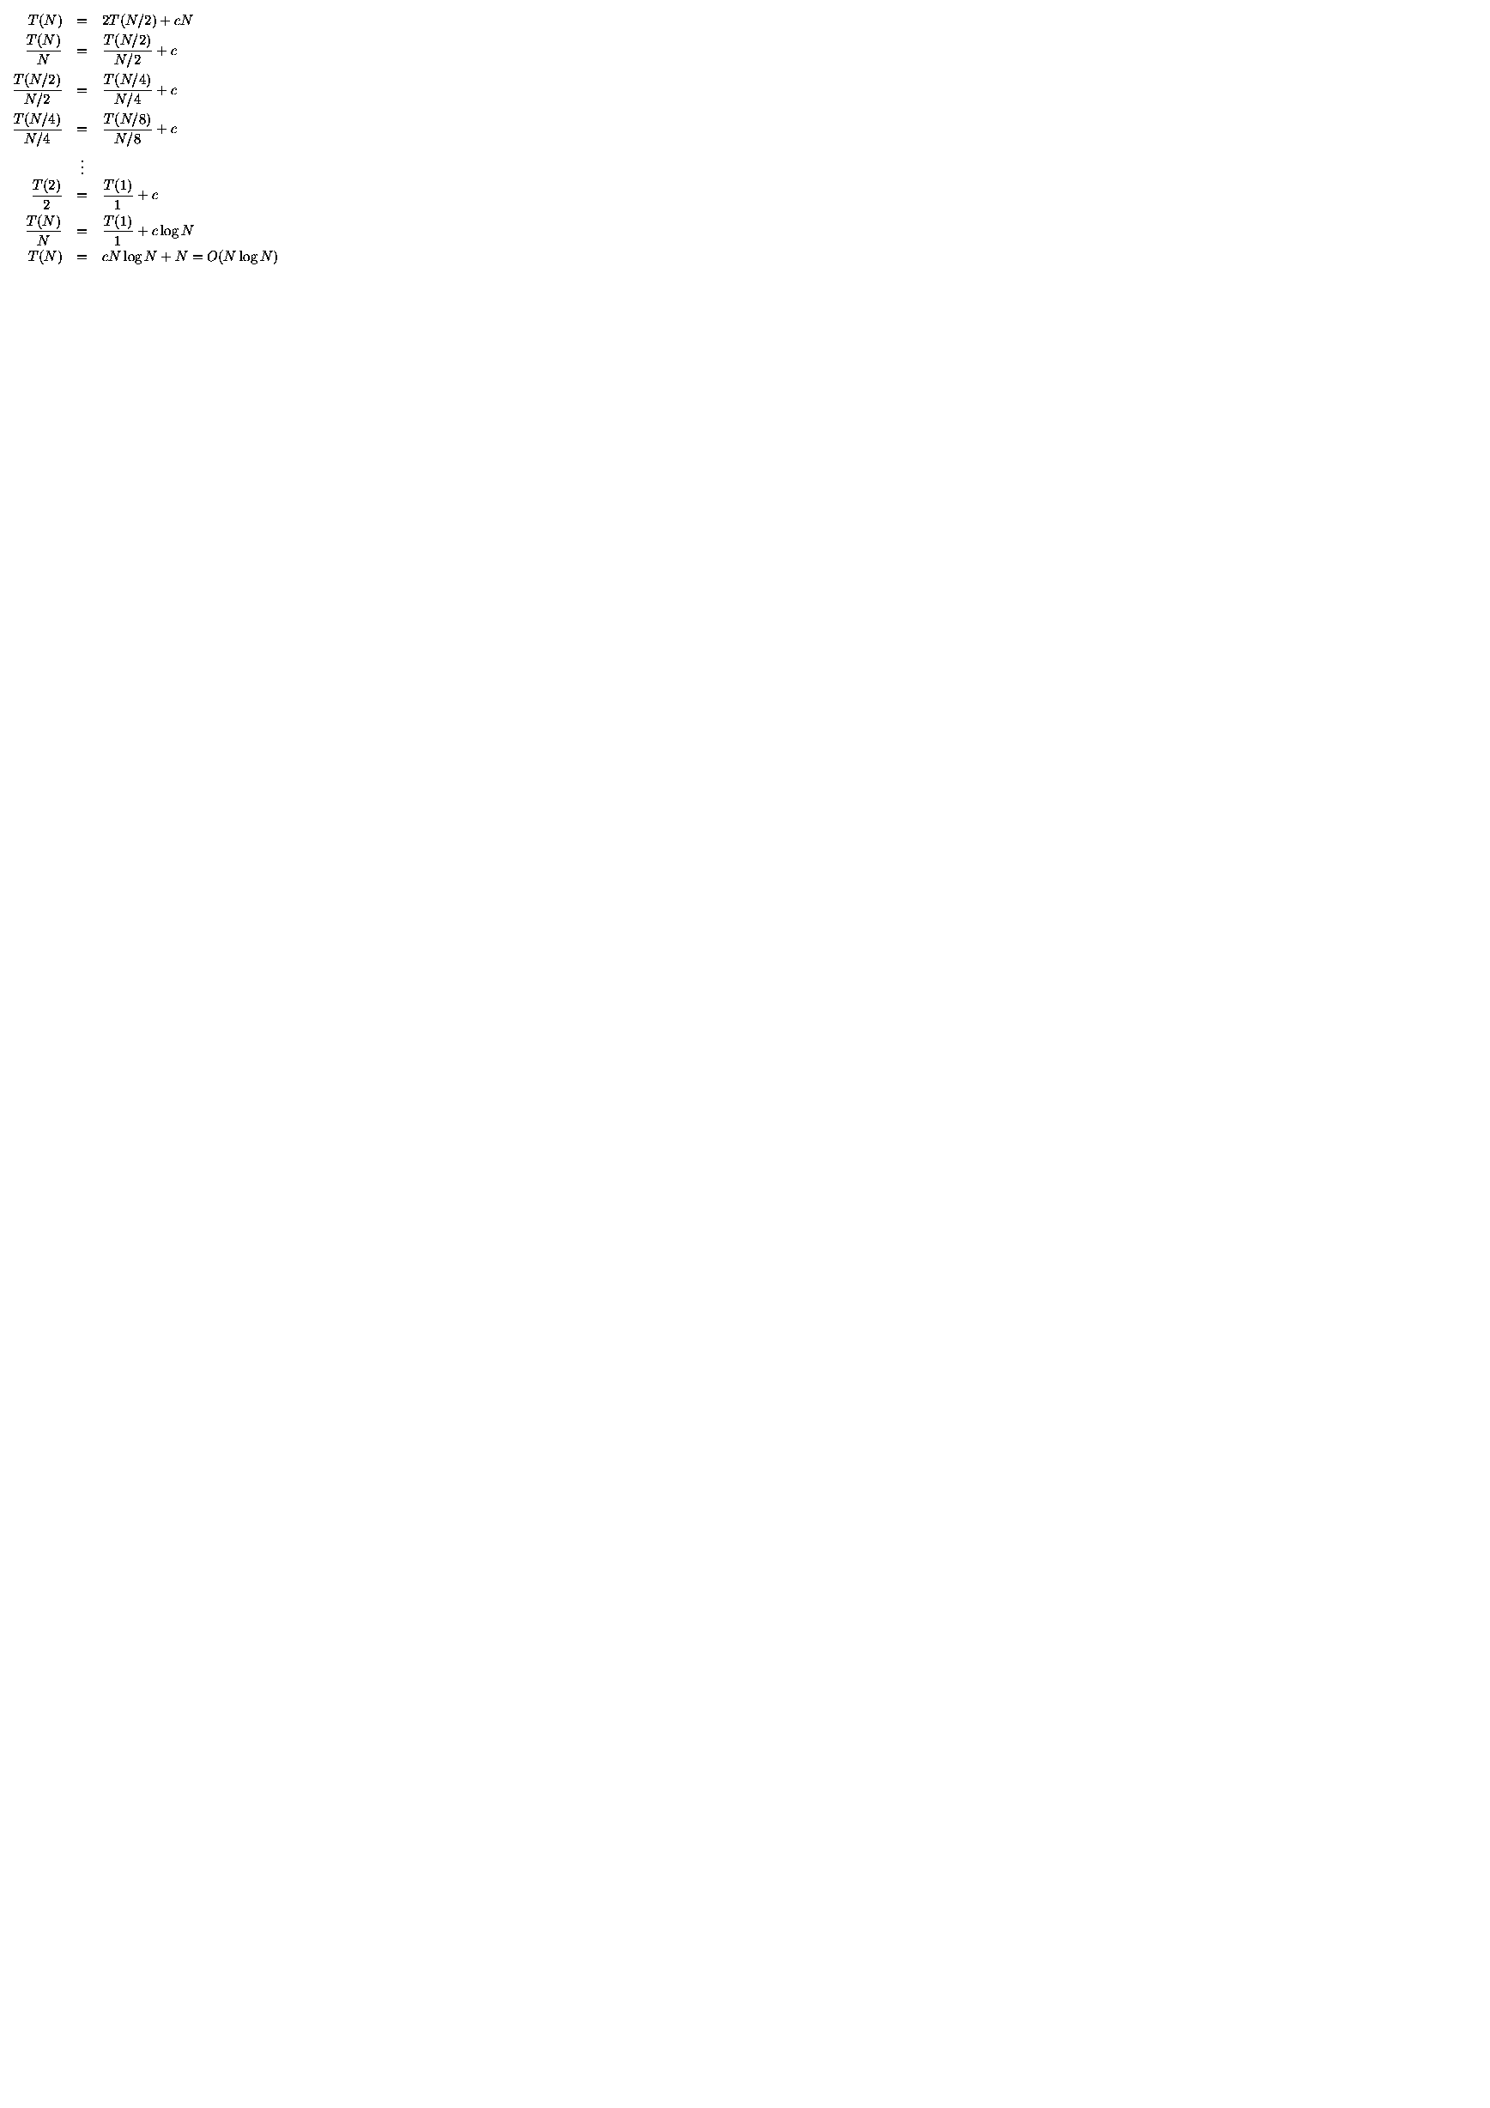
Best-case Analysis
What will be the best case?
Partition is perfectly balanced.
Pivot is always in the middle (median of the array)

